Slide 1
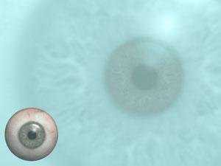
DETECTION ANALYSIS OF DIABETIC RETINOPATHY
Dinesh Goutham Gandla : UC05573
Sai Sujith Reddy Chagam : XF15736
Akhileshwar Rao Emmanani : NI74131

Slide 2
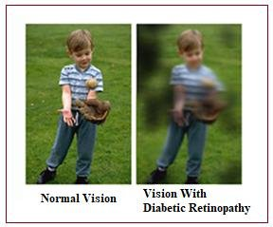
INTRODUCTION
Diabetic retinopathy is a critical complication of diabetes, directly affecting the retina and causing severe vision impairment. It specifically targets the retina, the critical part responsible for vision.
Consequences:
Causes extensive damage to blood vessels within the retina.
Results in blockages, leakage, and abnormal blood vessel growth.
Vision Implications:
Leads to bleeding, scarring, and permanent vision loss.
Diabetic macular edema (DME), involving the central retina, is a common cause of irreversible vision damage.

Slide 3
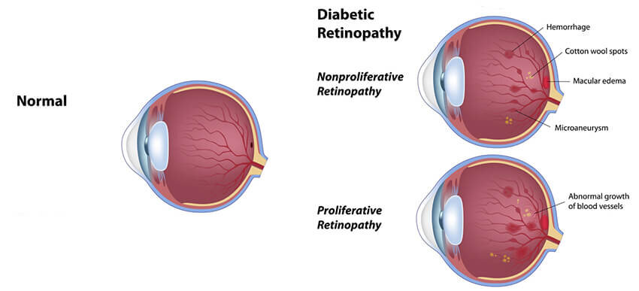
STAGES OF RETINOPATHY
Non-Proliferative Retinopathy:
Less severe form of the condition.
Cause harm to the delicate blood vessels in the retina
Resulting in swelling and the leakage of fluid and blood
Proliferative Diabetic Retinopathy :
Progressed form of diabetic eye disease
Neovascularization
obstruct the entire field of vision.
source

Slide 4
BACKGROUND AND MOTIVATION
Effective medication and regular monitoring of the eyes can potentially lower the incidence of new cases of DR by up to 90%.
Current Screening: Manual by ophthalmologists, highly time-consuming.
Introduction of Artificial Intelligence algorithms for automated detection and classification.
Existing Research Limitations: Less use of image pre-processing
Data Scarcity: Insufficient fundus defect data
Inconsistent detection rates for fundus defects, hindering accuracy.
Aiming for improved accuracy and efficiency in DR identification.

Slide 5
OBJECTIVES AND PROBLEM STATEMENT
To employ state-of-the-art approaches like DensNet-121 for the task of detection of diabetic retinopathy.
To initialize the pre-processing by doing morphological operations to manipulate the input image accordingly yet achieve superior results.
To build a model that Identifies and classifies Fundus images into 7 different defect classes.
To compare the results of our modified model with those of the existing architectures to assess its effectiveness.

Slide 6
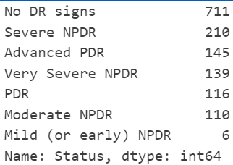
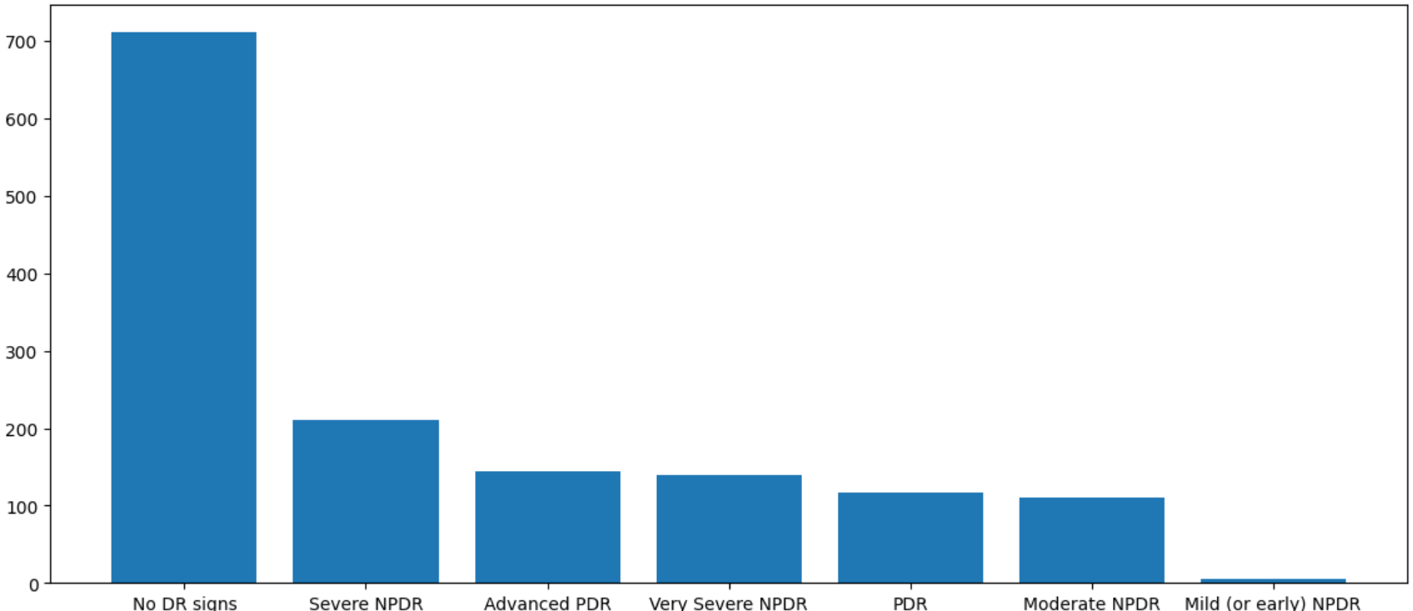
ABOUT Dataset
Dataset comprises 1437 retinal images exhibiting varying degrees of diabetic retinopathy.
Has 7 different categories
Unbalanced Dataset
Data acquired at the Department of Ophthalmology of the Hospital de Clínicas, Facultad de Ciencias Médicas, Universidad Nacional de Asunción, Paraguay.
Expert ophthalmologists have classified the dataset.

Slide 7
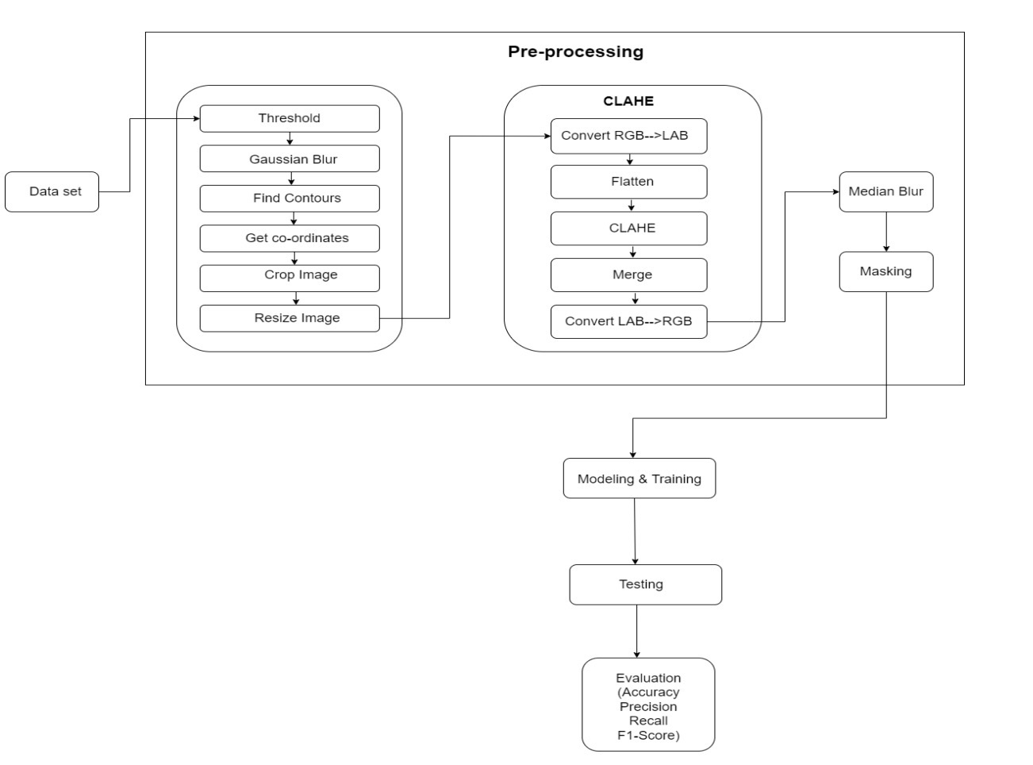
SYSTEM ARCHITECTURE

Slide 8
DATA AUGMENTATION
Introduce some noise to dataset.
Create new and realistic variations of the original data.
Rotation of 40° ,horizontal flip, shear transformation and zoom transformation with the range of 15%
Ability to handle different scenarios and generalize well to unseen data.
Enhance the performance and generalization of models trained on image data

Slide 9
DATA HANDLING
Resize all images to a standard 224x224 pixel size.
Original images were in BGR (Blue, Green, Red) format; converted to RGB for broader model compatibility.
RGB format is widely used in deep learning models.
Standardization enhances compatibility, enabling precise and efficient analysis of diabetic retinopathy.

Slide 10
MORPHOLOGICAL OPERATIONS
Morphological Operations
Gaussian blur
Threshold
Finding contours
Cropping and resizing the images

Slide 11
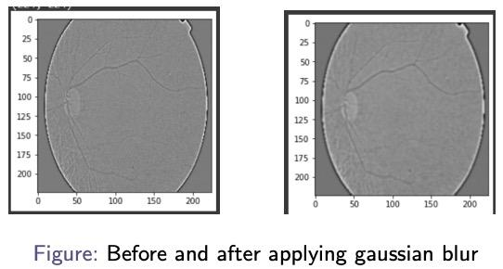
MORPHOLOGICAL OPERATIONS
The first step is to convert the RGB images to Grayscale images.
Gaussian blur : a smoothing operation that reduces noise and removes small details from the image.
Thresholding :With the help of the threshold we find high-intensity and low-intensity pixel values to get the coordinates of the image.
Get the contours of the image, we then crop and resize the image

Slide 12
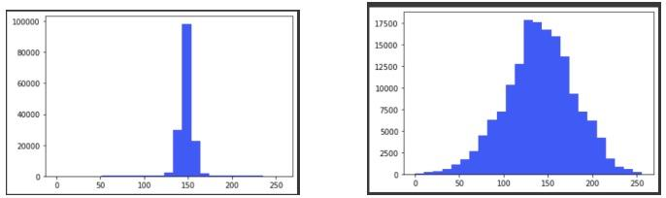
CLAHE
CLAHE stands for Contrast Limited Adaptive Histogram Equalization.
Enhances the contrast of an image by redistributing the intensity values in the image
Process Overview:
Convert RGB to LAB color space.
Flatten luminance channel for grayscale input.
Apply CLAHE algorithm for adaptive contrast enhancement.
Merge processed luminance with original color channels.
Convert LAB back to RGB for final output.
Benefits: Improved visualization for better analysis, enhanced contrast aids in diagnosing diabetic retinopathy.

Slide 13
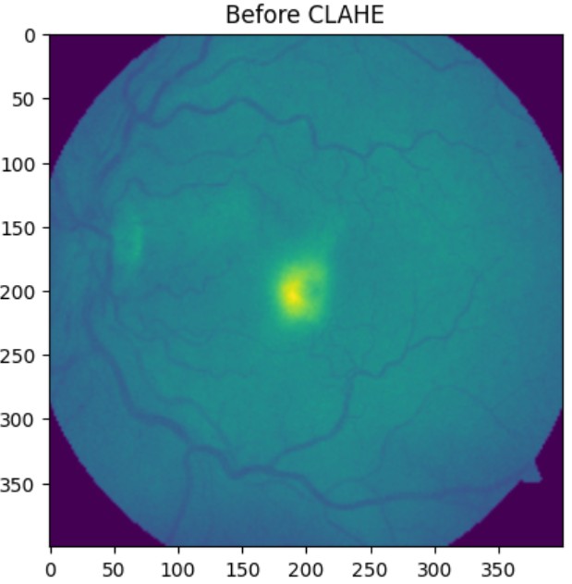
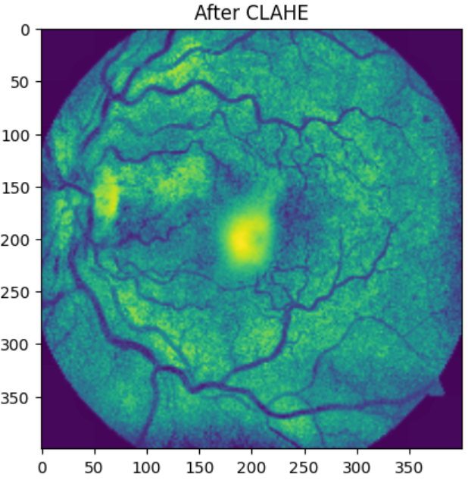

Slide 14
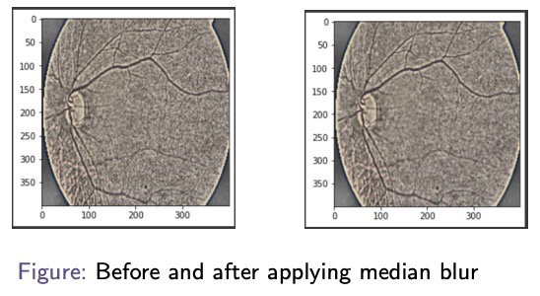
MEDIAN BLUR AND MASKING
CLAHE procedures may introduce noise impacting image accuracy.
Median Blur Eliminate noise while retaining edges and features.
Replace pixels with median values from neighbors.
Removes noise without substantial blurring.
masking certain areas of an image, we can focus on specific details and enhance the overall visual impact of the image.

Slide 15
METHODOLOGY
Following are the Models which we are going to use for the research purpose:
Simple CNN Model
VGG19
DenseNet169
DenseNet121
ResNet152

Slide 16
SIMPLE CNN MODEL
Designed Custom CNN model
Incorporates a Convolutional Neural Network (CNN) architecture with a total of 10 layers
It consists of 6 convolution layers, 7 dense layers, 4 MaxPool layers and 1 SoftMax layer.
Utilizing 3x3 filters with a stride of 1
Max-pooling layers using 2x2 filters with a stride of 2.
We didn’t get promising results with this model

Slide 17
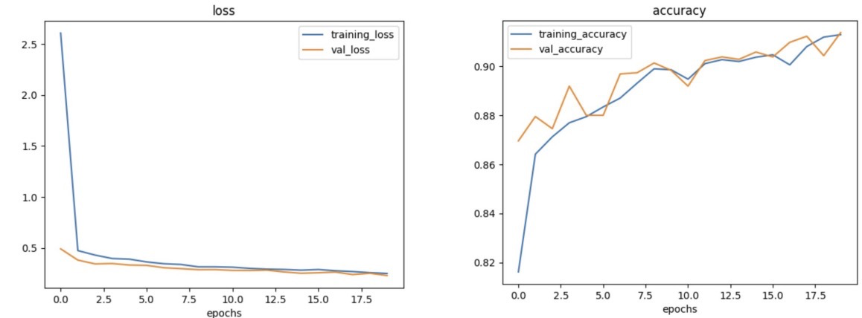
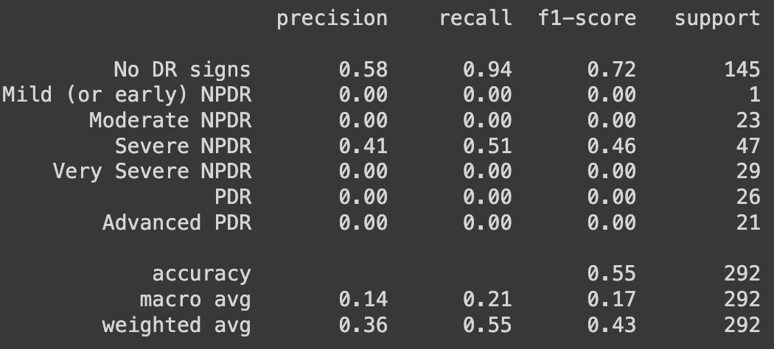
RESULTS
Loss and Accuracy graphs of CNN MODEL
Results of CNN MODEL

Slide 18
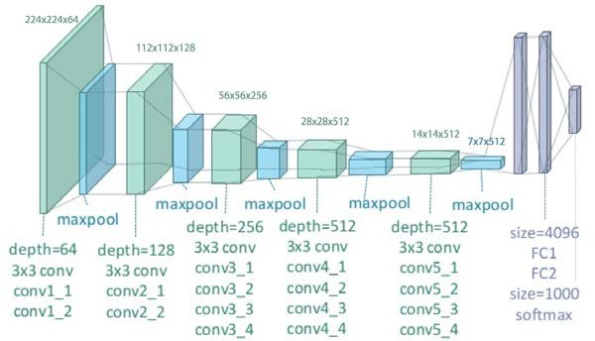
VGG-19
VGG19 is a variant of VGG model which in short consists of 19 layers.
It consists of 16 convolution layers, 3 Fully connected layer, 5 MaxPool layers and 1 SoftMax layer.
The fully connected layers have 4096 units each, concluding with a softmax layer for classification.
It also maintains the consistency of using 3x3 filter with stride 1 and padding and maxpool layer of 2x2 filter of stride 2
VGG-19's additional layers enable deeper feature extraction, potentially capturing more intricate patterns in data.
Architecture of VGG-19
source

Slide 19
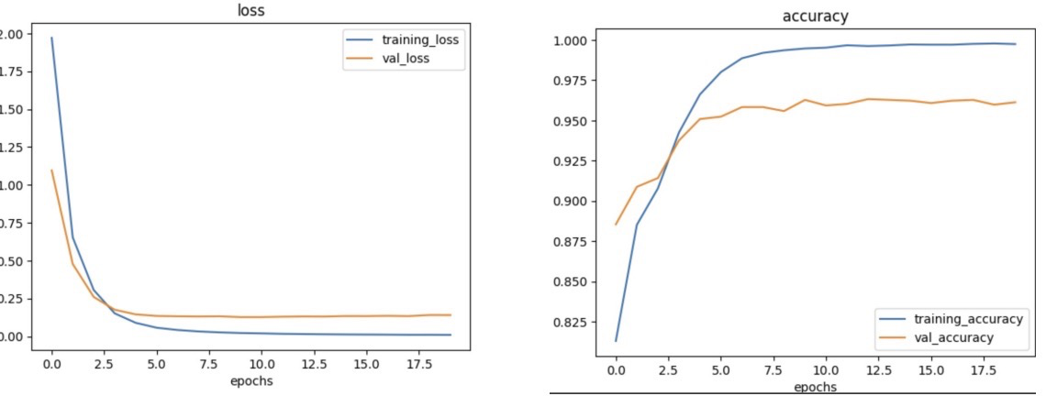
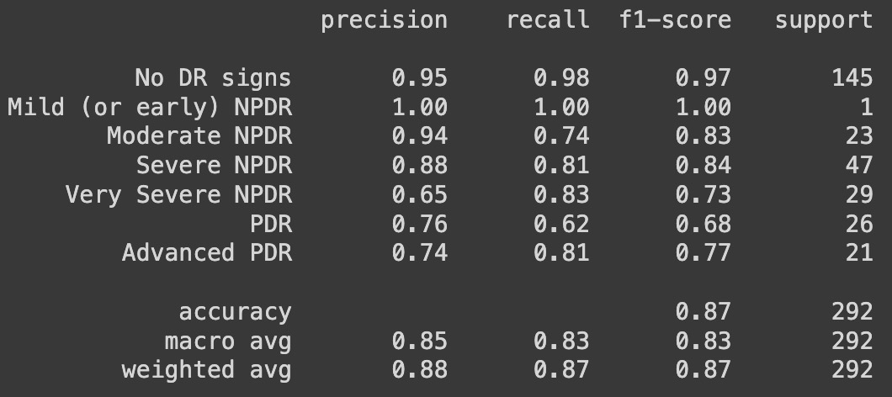
RESULTS
Loss and Accuracy graphs of VGG-19 MODEL
Results of VGG19 MODEL

Slide 20
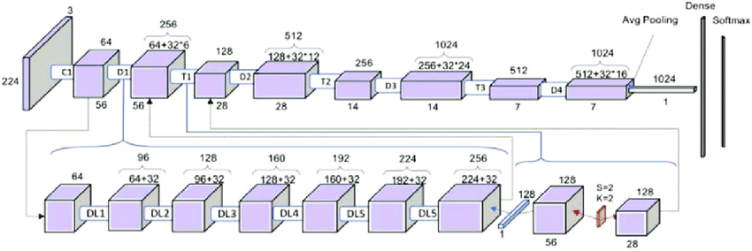
DENSNET-121
DenseNet-121 is a convolutional neural network architecture renowned for its connectivity pattern.
It comprises 121 layers, characterized by dense connections between layers.
The network architecture incorporates four dense blocks, each with multiple convolutional layers.
DenseNet-121's unique feature is its dense connectivity, where each layer receives direct inputs from all preceding layers.
This architecture reduces the vanishing-gradient problem, encourages feature reuse, and facilitates information flow throughout the network.
It culminates in a global average pooling layer and a softmax layer for classification.
Architecture of DensNet121
source

Slide 21
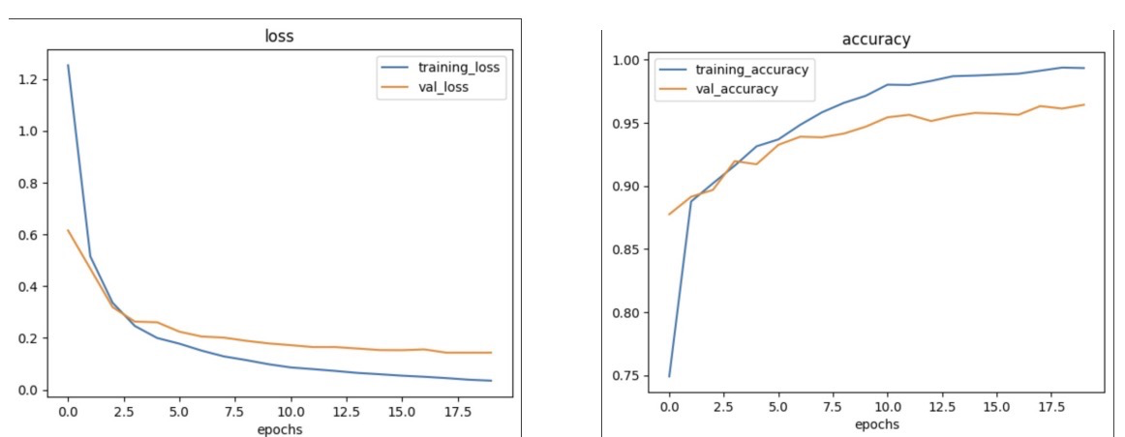
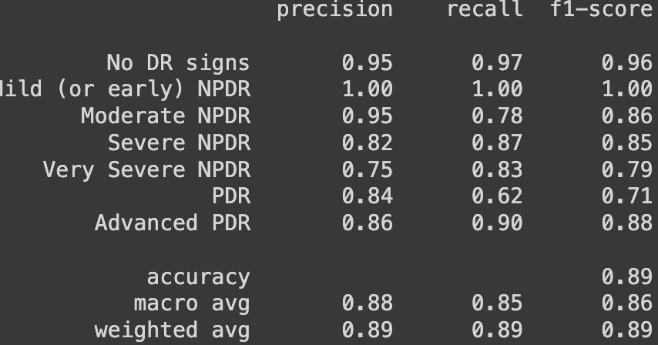
RESULTS
Loss and Accuracy graphs of DensNet121 MODEL
Results of DensNet121 MODEL

Slide 22
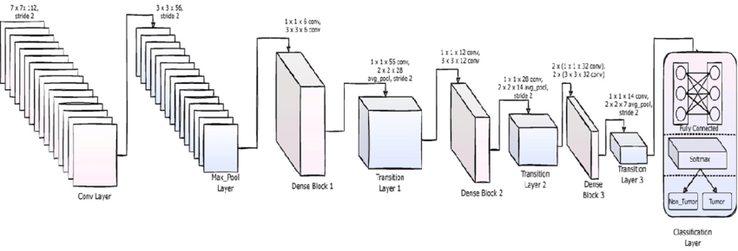
DENSNET-169
DenseNet-169 extends the concept of dense connectivity seen in DenseNet-121, comprising 169 layers.
It features a more complex architecture, including additional dense blocks and growth in the number of convolutional layers.
With its dense connections, DenseNet-169 allows for improved information flow and gradient propagation.
The network's increased depth enhances its capability to capture intricate features in various datasets.
Similar to DenseNet-121, it also ends with a global average pooling layer followed by a softmax layer for classification.
Architecture of DensNet169
source

Slide 23
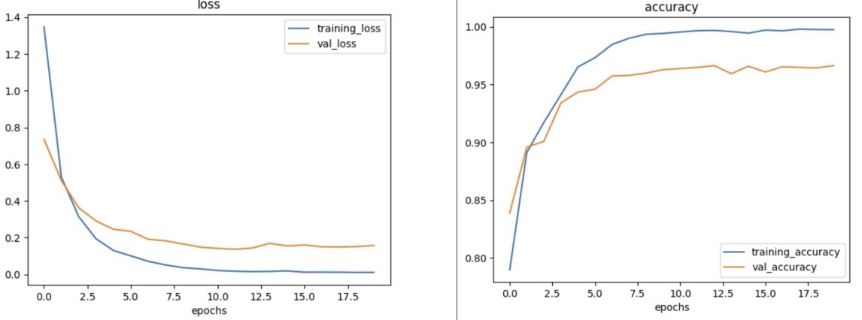
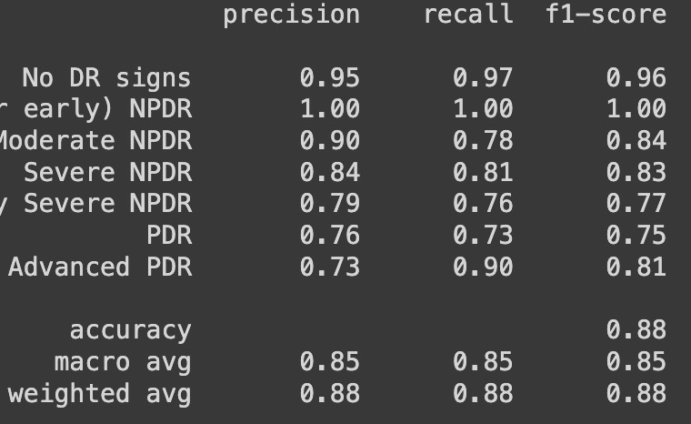
RESULTS
Results of DensNet169 MODEL
Loss and Accuracy graphs of DensNet169 MODEL

Slide 24
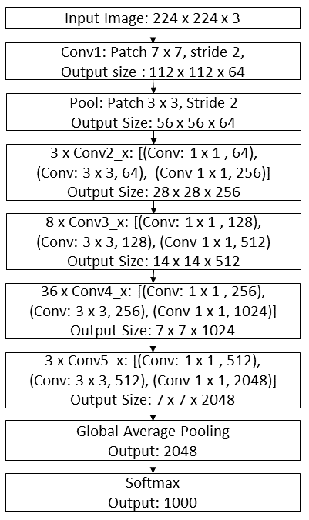
RESNET-152
ResNet-152 is a deep convolutional neural network known for its residual learning framework.
It stands out due to its 152 layers, making it significantly deeper than previous architectures.
ResNet-152 innovates with residual blocks featuring shortcut connections that facilitate direct gradient flow, addressing vanishing/exploding gradient issues in deep networks.
The skip connections in ResNet-152 facilitate the training of extremely deep networks by mitigating degradation issues.
This architecture excels in feature extraction and learning intricate patterns, making it effective in various complex tasks.
ResNet-152 culminates in global average pooling and a softmax layer for classification purposes.
Architecture of ResNet152
source

Slide 25
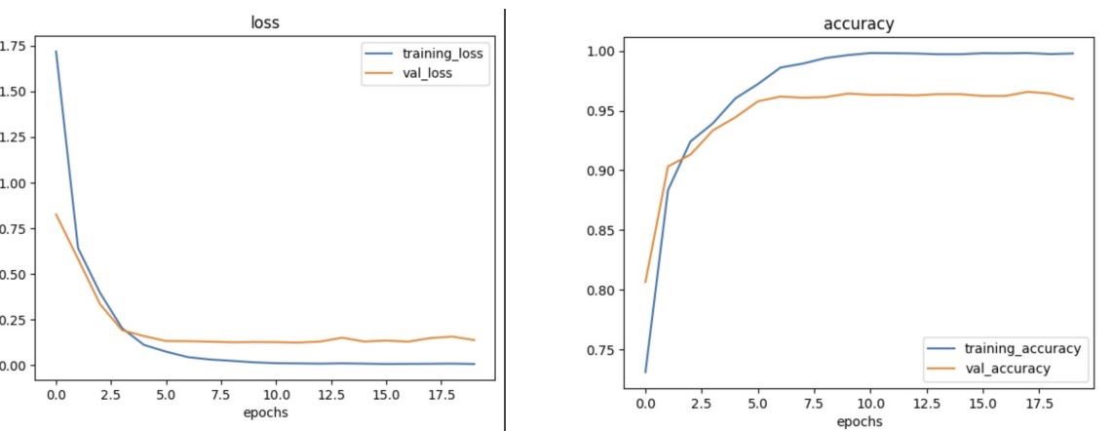
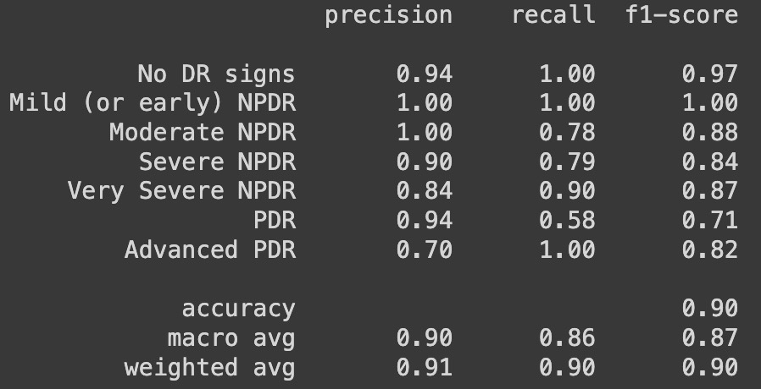
RESULTS
Loss and Accuracy graphs of ResNet152 MODEL
Results of ResNet152 MODEL

Slide 26
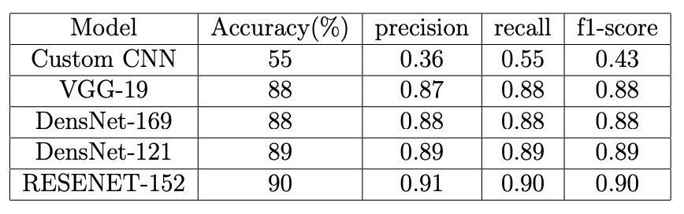
RESULTS SUMMARY

Slide 27
CONCLUSION
Successfully addressed diabetic retinopathy detection using a range of deep learning models.
Achieved an impressive 90% accuracy with ResNet-152 architecture and outperformed other models in the study.
Experimentation focused on accuracy, precision, recall, and f1-score using five architectures.
Results offer insights into architecture effectiveness and pre-processing techniques.
Success with Resent-152 motivates further exploration of new techniques and architectures to enhance model accuracy and effectiveness
Acknowledged limitations, highlighting the need for further testing on larger datasets.

Slide 28
REFERENCES
V. E. Castillo Benítez, I. Castro Matto, J. C. Mello Román, J. L. Vázquez Noguera, M. García-Torres, J. Ayala, D. P. Pinto-Roa, P. E. Gardel-Sotomayor, J. Facon, and S. A. Grillo, Dataset from fundus images for the study of diabetic retinopathy, Data in Brief, vol. 36, p. 107068, Jun. 2021. doi: https://doi.org/10.1016/j.dib.2021.107068
S. Sanjana, N. S. Shadin, and M. Farzana, “Automated diabetic retinopathy detection using transfer learning models,” in 2021 5th International Conference on Electrical Engineering a
M. Z. Atwany, A. H. Sahyoun, and M. Yaqub, “Deep learning techniques for diabetic retinopathy classification: A survey,” IEEE Access, vol. 10, pp. 28 642–28 655, 2022.
S. H. Kassani, P. H. Kassani, R. Khazaeinezhad, M. J. Wesolowski, K. A. Schneider, and R. Deters, “Diabetic retinopathy classification using a modified xception architecture,” in 2019 IEEE International Symposium on Signal Processing and Information Technology (ISSPIT), 2019, pp. 1–6.
E. V. Carrera, A. Gonz´alez, and R. Carrera, “Automated detection of diabetic retinopathy using svm,” in 2017 IEEE XXIV International Conference on Electronics, Electrical Engineering and Computing (INTERCON), 2017, pp. 1–4.

Slide 29
GITHUB
https://github.com/Goutham24/Diabetic-Retionapthy-Detection.git

Slide 30
THANK YOU

